Slide 1
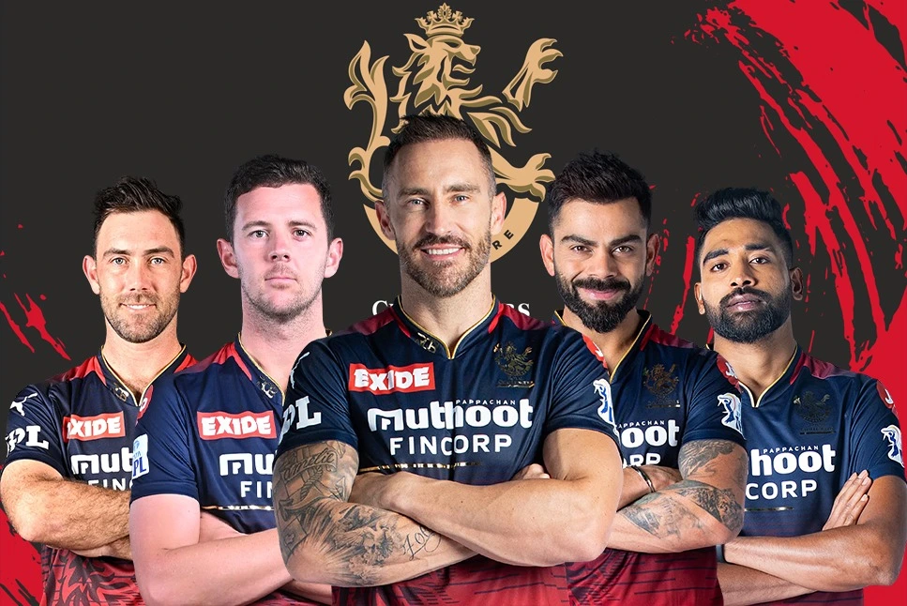
RCB – IPL STRATEGY And ANALYSIS for Mega Auction 2017
Submitted by : Lalit Kaushik
Date: 06/11/2024

Slide 2
IPL History and Overview
Introduction: The Indian Premier League (IPL) is a professional Twenty20 cricket league in India, established by the Board of Control for Cricket in India (BCCI) in 2008.
Format: It features city-based franchise teams, with matches played in a round-robin and knockout format.
Popularity: Known for its high entertainment value, the IPL has become one of the most-watched cricket leagues globally, combining top cricket talent with Bollywood glamour.
Franchises: The league started with eight teams, and franchises have included cities like Mumbai, Chennai, Bangalore, and Kolkata.
Influence: The IPL has revolutionized the sport, popularizing the T20 format and significantly boosting the careers of many cricketers.

Slide 3









Teams Played in IPL 2016

Slide 4
Problem Statement
I am Hired as a sports data analyst by RCB where the team is looking for Top- performing and reliable players to win tournaments , considering both on field performance and value for money in mega player auction of 2017.
My task is to come up with strategies /suggestions regarding selecting the best performing players and optimizing player auction investments.

Slide 5
Data Description
Ball by Ball: Key attributes for detailing each ball in a cricket match: unique identifiers for match, over, ball, innings number, batting and bowling teams, striker's batting position, striker, non-striker, and bowler.
Batting style : Key attributes for a batsman's record: unique identifier and batting hand (right or left).
Bowling style : Key attributes for a bowler's record: unique identifier and bowling skill (e.g., right-arm fast, left-arm spin).
Extra Type : Uniquely identifies the type of extra runs (Extra_Runs) scored in a cricket match, categorized by innings (Innings_No) and instance (Extra_Id), with Extra_Name specifying the type (e.g., byes, leg byes, wides, no-balls).
Season: Uniquely identifies a specific season or tournament, while Venue_Id pinpoints the stadium or venue where the match is held.

Slide 6
Key Focus Area on Auction
Player Analysis and Selection
Consistency and Form: Focus on players with consistent performance and recent form.
Injury History: Consider players' injury history and current fitness levels.
Team Composition and Balance
Role Distribution: Ensure a balanced mix of batsmen, bowlers, all-rounders, and wicketkeepers.
Specialists vs. All-rounders: Determine the right balance between specialist players and all-rounders.
Financial Strategy
Budget Allocation: Set clear budget limits for different player categories.
Value for Money: Identify players who offer the best value for their price.
Bid Strategy: Plan a strategic bidding approach to avoid overspending on marquee players.
Youth and Future Potential
Young Talent: Focus on acquiring young and emerging players with long-term potential.
Player Development: Invest in players who can be developed and integrated into the team over time.

Slide 7
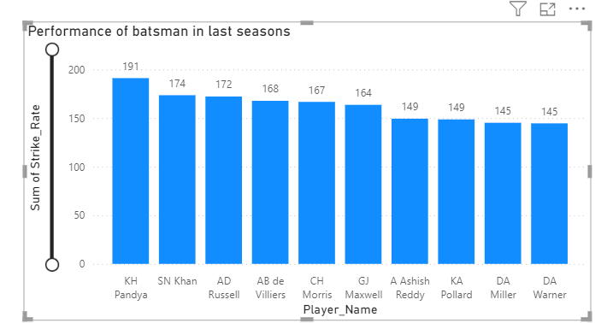
Historical Performance Data
As we can see in the charts the top performing batsmen in the last season based on their strike rate .
KH Pandya with a strike rate of 191
SN Khan with a strike rate of 174
AD Russell with a strike rate of 172
AB de Villiers with a strike rate of 168
CH Morris with a strike rate of 167
KH Pandya and SN Khan have
Shown exceptional performance ,
making them valuable
assets for aggressive
batting strategies

Slide 8
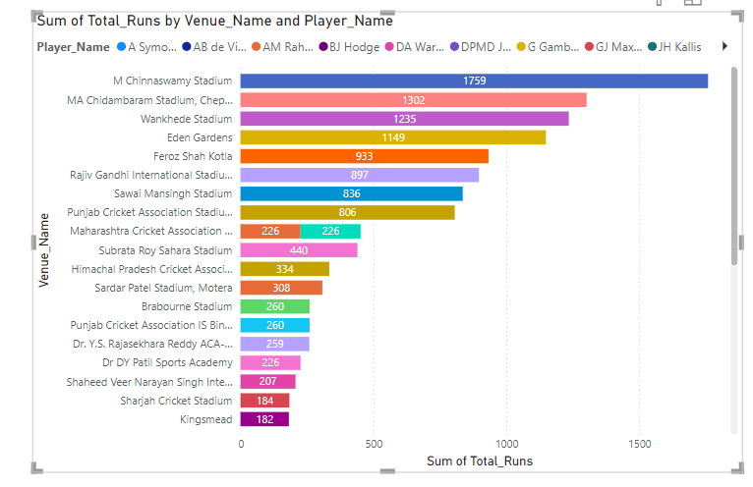
Total Runs
Sum of total runs by Venue_Name and Player_name

Slide 9
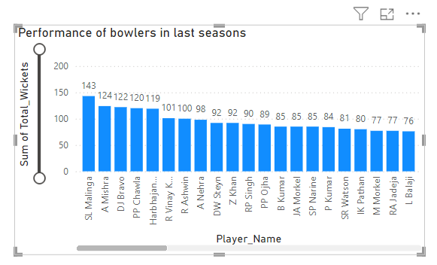
Bowling Metrics
Malinga and A Mishra have been consistent wicket takers indicating their effectiveness in controlling the game and taking
crucial wickets.
DE Bollinger, SP Raina, S Aravind have the best bowling averages showcasing their efficiency in taking wickets while conceding fewer runs
SL Malinga: 143 wickets, 2564 runs conceded, average 17.80
DE Bollinger: 37 wickets, 693 runs conceded, average 18.73
S Aravind: 45 wickets, 764 runs conceded, average 18.90
SP Narine: 106 wickets, 1636 runs conceded, average 20.43
MM Patel: 126 wickets, 2864 runs conceded, average 22.73
YS Chahal: 125 wickets, 2803 runs conceded, average 22.42
A Singh: 144 wickets, 3231 runs conceded, average 22.44

Slide 10


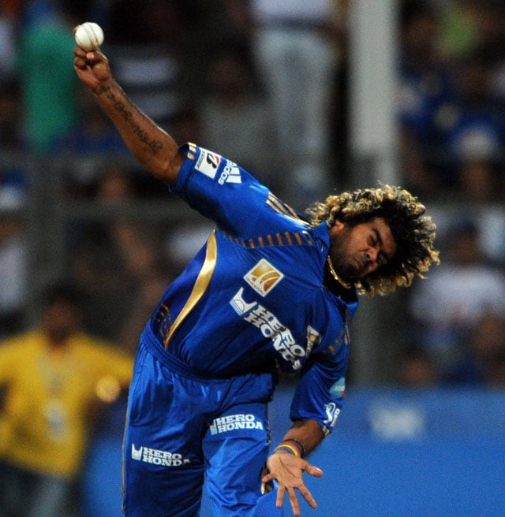
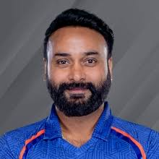
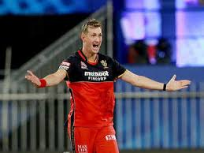

ing players
Hardik Pandya: Strike Rate is highest 191.3
SK Raina: Total runs sored is highest 4106
SL Malinga: Total wickets taken are 143
A Mishra: Total wickets taken are 124
CH Morris: Batting Average is 41 and Bowling Average is 25
SR Watson : Batting Average is 32 and Bowling Average is 27
YK Pathan : Batting Average is 31 and Bowling Average is 34

Slide 11
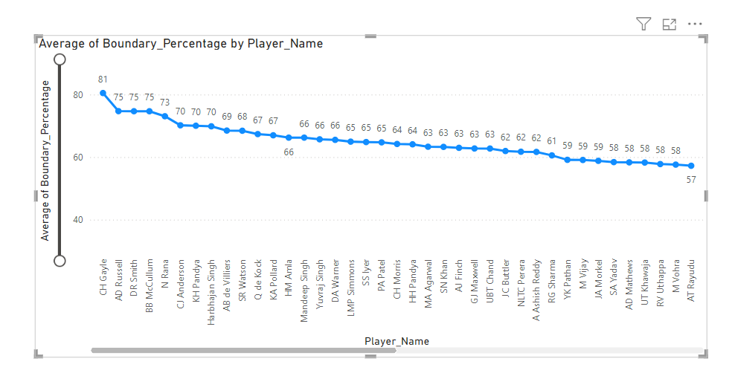
Highest number of Sixes by Players
Top Performers:
CH Gayle: 81%
AD Russell: 75%
Consistent Performers:
N Rana: 70%
CI Anderson: 70%
High Boundary Scorers: CH Gayle and AD Russell stand out as the top boundary scorers, reflecting their aggressive batting style and ability to change the game quickly.
Balanced Scorers: Players like AB de Villiers and SR Watson show a balanced approach with high boundary percentages, making them reliable for consistent boundary hitting.
Valuable Assets: Players with boundary percentages around 65-70% like KH Pandya, N Rana, and Q de Kock are crucial for maintaining pressure on the bowling team and accelerating the run rate.

Slide 12
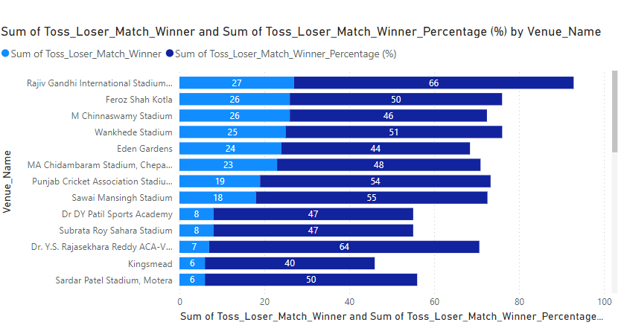
Key Venues with High Toss Loser Match Winners
Rajiv Gandhi International Stadium:
Matches Won: 27
Winning Percentage: 66%
Insights: Highest percentage of matches won by teams that lost the toss, indicating a less significant advantage of winning the toss at this venue.
Feroz Shah Kotla:
Matches Won: 26
Winning Percentage: 50%
Insights: Half of the matches were won by teams that lost the toss, showing a balanced impact of toss outcomes.
M Chinnaswamy Stadium:
Matches Won: 26
Winning Percentage: 46%
Insights: Nearly half the matches were won by toss losers, highlighting the competitive nature of the games at this venue.

Slide 13
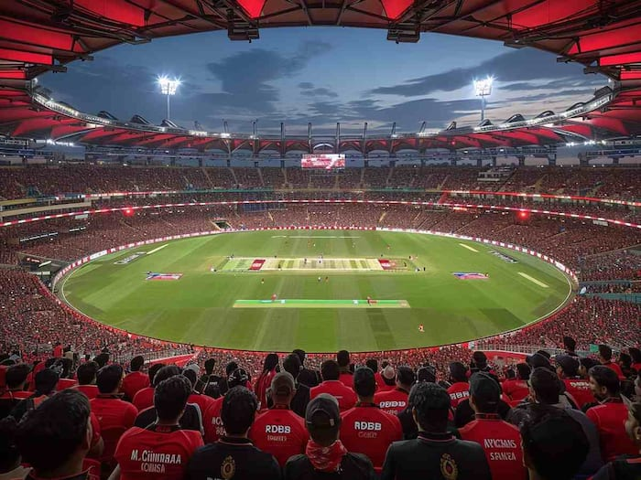
Home Ground advantage of RCB
RCB has played a total of 54 matches
at M. Chinnaswamy Stadium, winning 29
and losing 25. This gives them a
winning percentage of approximately 53.7%.
Strategies to Maximize Home Ground Advantage:
Specialized Training: Conduct regular practice sessions focusing on the unique aspects of the home pitch.
Player Selection: Choose players who perform
well in home conditions.
Fan Engagement: Enhance fan experience
to maintain strong crowd support.
Adaptation to Pitch: Develop strategies
that leverage the specific pitch characteristics,
such as focusing on spin or pace based on the ground’s history.

Slide 14
Auction Strategy
Bidding Tactics:
Early Bids vs. Late Bids:
Early Bids: Placing bids early can secure key players before the competition increases. This strategy is effective for players who are expected to attract high bids.
Late Bids: Waiting until the later stages can help in securing players at potentially lower prices as budget constraints come into play for other teams. This can be effective for under-the-radar or less popular players.
Targeting Uncapped Players:
Focusing on uncapped players can be cost-effective. These players often have high potential and can be game-changers. They are typically less expensive and provide great value for money.
Risk Management:
Backup Options:
Always have alternative choices for each position. If primary targets are outbid, having a list of secondary options ensures the team can still build a balanced squad without overspending.
Contingency Plans for Injuries:
Prepare for the possibility of injuries by selecting versatile players who can fill multiple roles. Having a well-thought-out plan for replacement players helps maintain team strength and performance levels.

Slide 15
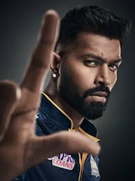
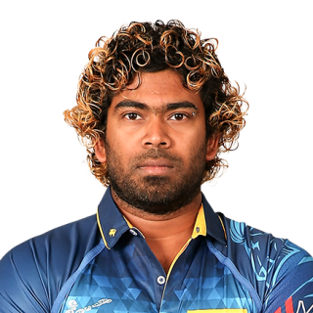
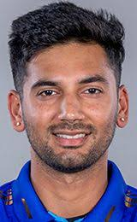
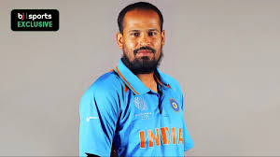

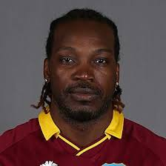
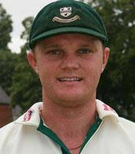
Recommended Players
Strike rate: 191
Boundary percentage: 69%
143 wickets,
2564 runs conceded,
average 17.80
45 wickets,
764 runs conceded,
average 18.90
Batting Average is 41
Bowling Average is 25
Batting Average is 31
Bowling Average is 34
Total runs: 4106
Average runs: 33.66
Boundary percentage: 81%, Average runs: 43.09
37 wickets,
693 runs conceded,
average 18.73
Batting Average is 32
Bowling Average is 27

Slide 16
Conclusion
Recap of Key Points:
Player Analysis and Selection:
Prioritization of consistency and recent form.
Consideration of injury history and fitness levels.
Ensuring a balanced team composition with a mix of specialists and all-rounders.
Financial Strategy:
Clear budget allocation for different player categories.
Identifying value-for-money players.
Strategic bidding to avoid overspending on marquee players.
Implementation Plan:
Develop a detailed auction strategy based on the outlined principles.
Conduct mock auctions to refine bidding tactics.
Collaborate with the coaching staff to align on player selection criteria.
Continuous Performance Monitoring:
Regularly track player performance throughout
the season.
Adjust strategies based on real-time data and match outcomes.
Use performance insights to make mid-season adjustments and future auction plans.
Importance of Data-Driven Decisions:
Utilizing historical performance data to guide auction strategies.
Leveraging player statistics to make informed selection decisions.
Ensuring a well-balanced team that maximizes performance and value

Slide 17
Acknowledgement
I acknowledge my mentor for this project for giving me insights about how we can use Excel to analyze. Also I would like to thank Newton School for providing me this platform to learn and improve my skills. Along with that my batchmates and the TA sessions also helped me in many ways to bring this PPT on the table

Slide 18

Thankyou

